Slide 1

Nykaa Brand Analysis
Prepared by: Manikandan M

Slide 2


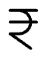



Company Overview
Founding
Market Leadership
Established in 2012 by Falguni Nayar.
India’s leading beauty & wellness e-commerce platform.
Product Range
Key Channels
Offers over 4000 brands, including its own private labels.
Operates through Nykaa (beauty), Nykaa Fashion, and Nykaa Man.
Public Listing
Listed on NSE & BSE stock exchanges in 2021.

Slide 3




How Nykaa Operates (Business Model)
Inventory-led Model
Omnichannel Presence
Direct selling from warehouse ensures quality control.
Online website/app + offline stores.
Diverse Revenue Streams
Focus on Tier II & III Cities
Product sales, private label, influencer marketing, fashion vertical.
Expanding reach to emerging markets.

Slide 4
Nykaa Revenue Model
Product Sales
Private Labels
Revenue from beauty, wellness, and fashion products.
Higher profit margins from in-house brands.
Advertisement Revenue
Nykaa PRO Subscription
Brands pay for promotions & visibility.
Premium membership income.
Delivery Charges
Income generated from delivery fees.

Slide 5

How Do Customers See Nykaa?
Innovative
Premium
Trusted
Authentic
Trendy

Slide 6

What Are Customers Saying?
Positive
Negative
Neutral
Authentic products
Delayed orders
Suggestions for more discounts
Wide brand range
Customer support issue
Suggestions for more store availability
User-friendly app
Less Discounts compare to others
Loyal customers

Slide 7





What’s Trending in the Beauty Industry?
Natural & Organic
Shift toward natural & organic products.
D2C Brands
Growth of D2C (Direct to Consumer) brands.
Tier II/III Demand
High demand in Tier II/III cities.
Beauty Tech
Rise of beauty tech (AI-based recommendations)
Influencer Marketing
Heavy influencer and short video-based marketing.

Slide 8

Who Competes with Nykaa?
Key Competitors:
Purplle
Myntra
Strength: Budget-friendly pricing
Strength: Strong fashion-beauty combo
Weakness: Limited premium brand selection
Weakness: Less specialized in beauty
Key Differentiator: Value-for-money focus
Key Differentiator: Integrated fashion and beauty platform
Amazon/Flipkart
Tira (Reliance)
Strength: Vast variety, wide reach
Strength: Deep retail pockets, aggressive expansion
Weakness: Lack curation, authenticity concerns
Weakness: New entrant, building trust
Key Differentiator: General e-commerce giants
Key Differentiator: Emerging big competitor with strong backing

Slide 9
Nykaa Competitor Analysis
Direct Competitors
Brand
Segment
Type
Purplle
Beauty & Personal Care
Online
Myntra
Fashion, Beauty & Lifestyle
Online
Amazon
General Marketplace (Beauty incl.)
Online
Flipkart
General Marketplace
Online
Sephora India
Luxury Beauty
Offline + Online
Tira (by Reliance)
Beauty & Personal Care
Offline + Online

Slide 10
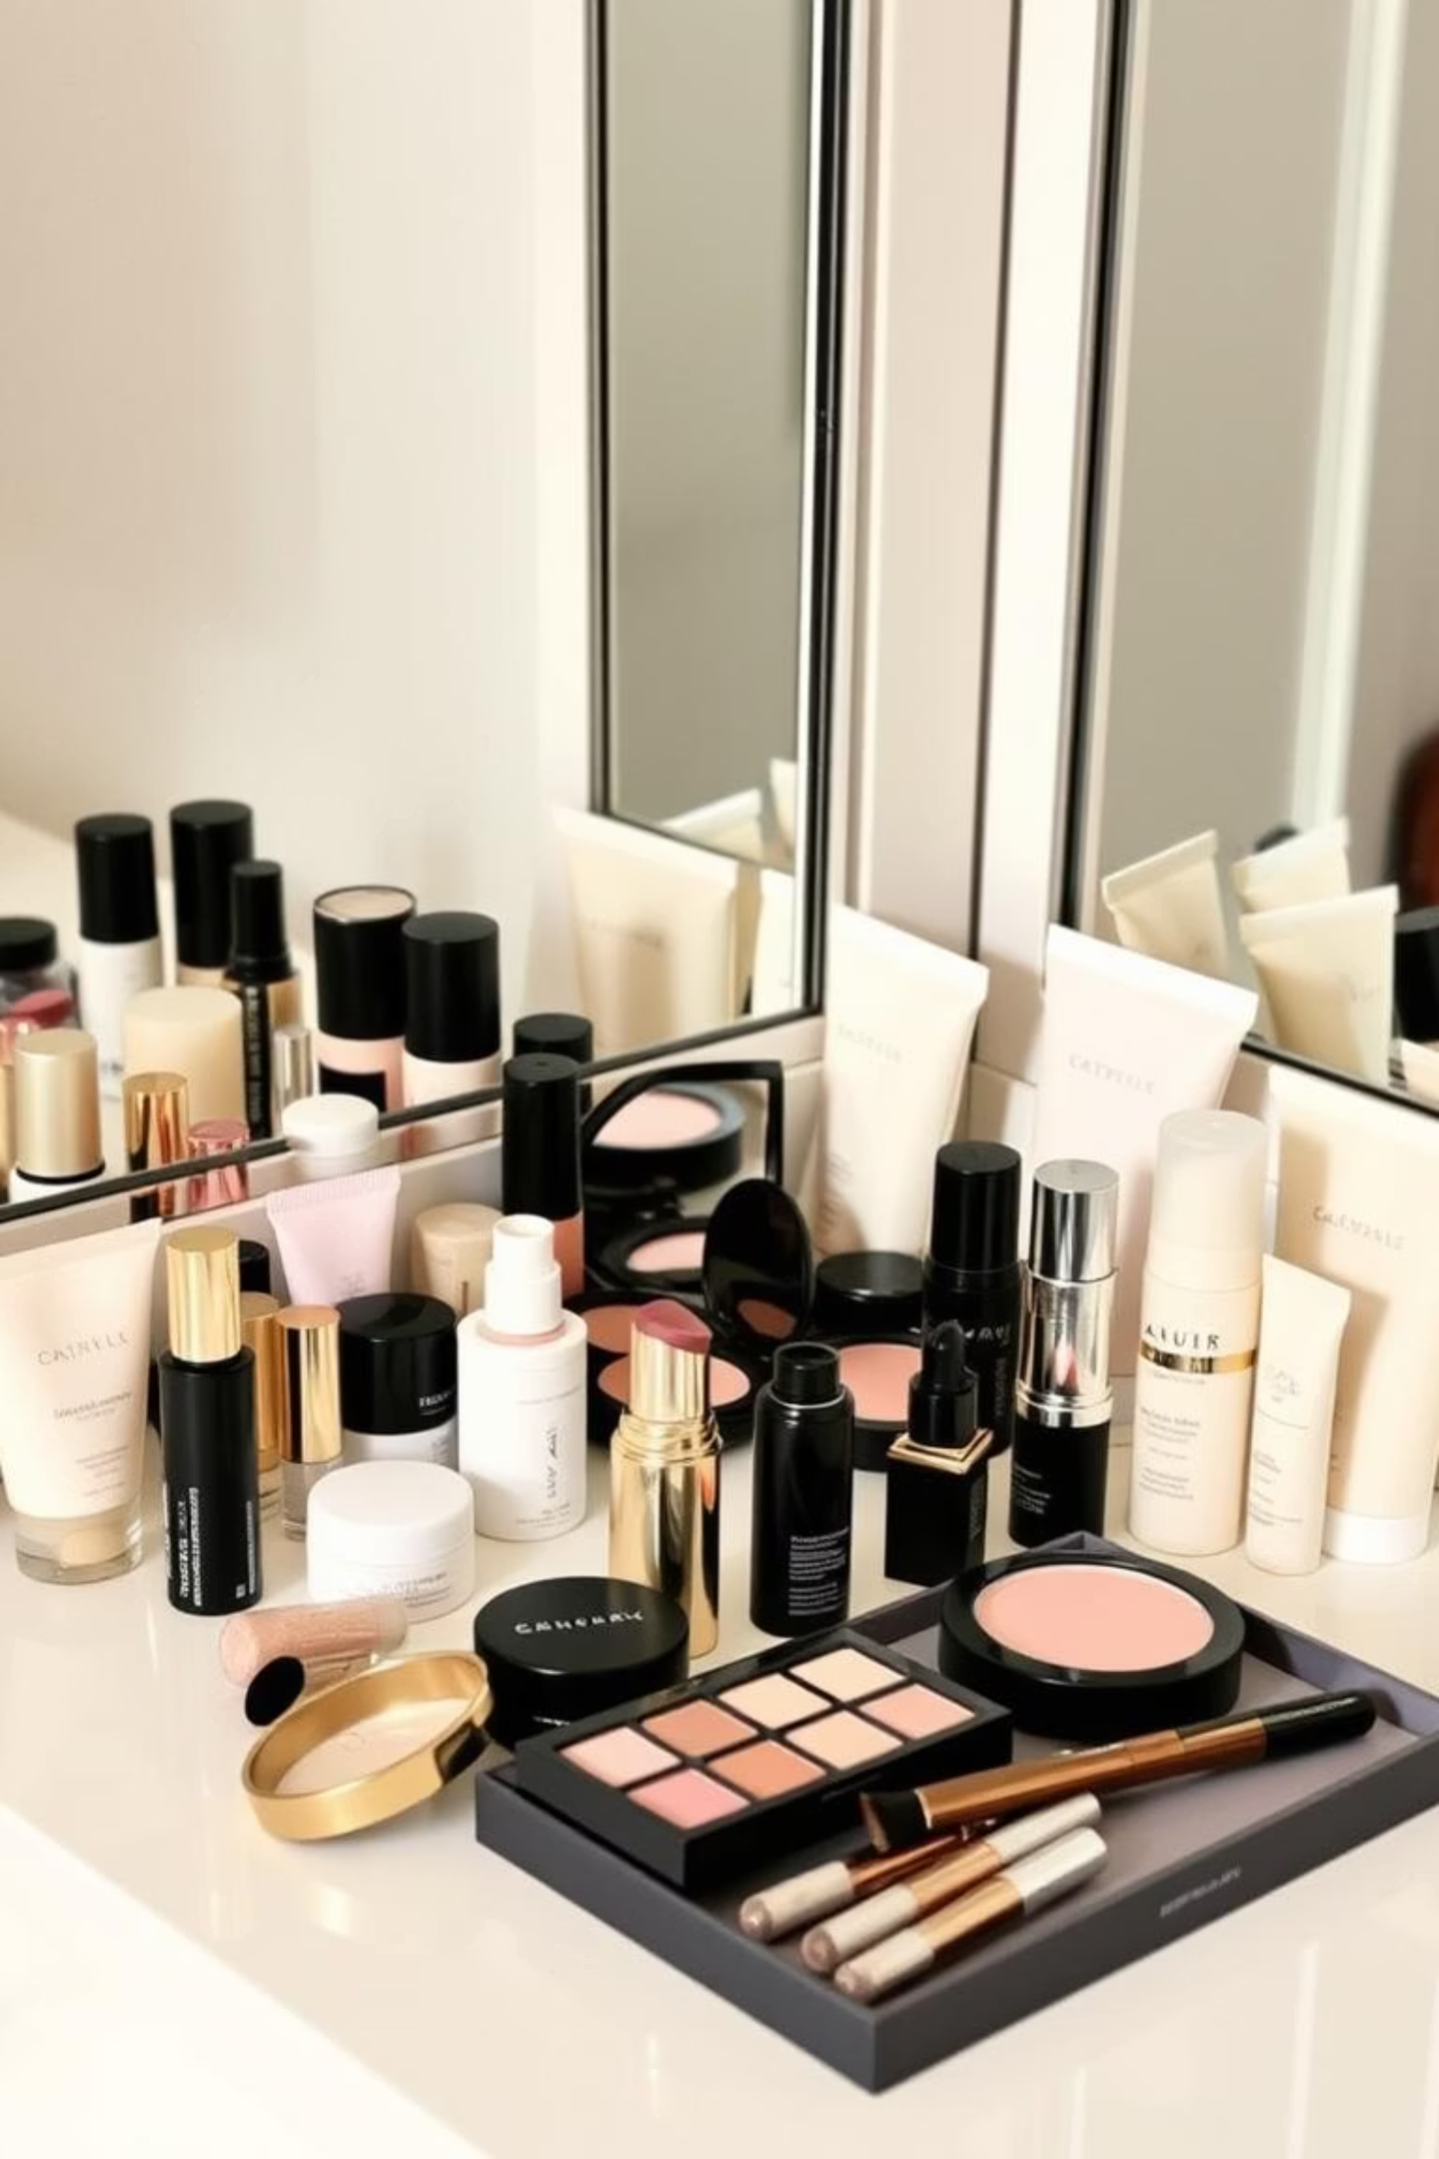
Competitive Positioning
Feature / Brand
Nykaa
Purplle
Myntra
Tira
Sephora
Own Brand Products
✔
✔
✖
✖
✖
Offline Presence
✔
✖
✖
✖
✔
High-End Brands
✔
✖
✔
✔
✔
Content + Commerce
✔
✖
✔
✖
✖
Loyalty Program
✔
✔
✔
✖
✔
Fast Delivery
✔
✔
✔
✔
✔

Slide 11




Challenges from Competitors
Tira (Reliance)
Purplle
Backed by Reliance's strong retail and logistics network, posing a significant threat(High Risk).
Operates in a similar segment with aggressive pricing and strong outreach in Tier-2 cities (High Risk).
Amazon/Flipkart/Myntra/Ajio
Sephora/Tata CliQ
Leverage their massive user bases and ability to bundle beauty products with other categories (Medium Risk).
Primarily focuses on the luxury segment, limiting its overall market reach (Low Risk).

Slide 12
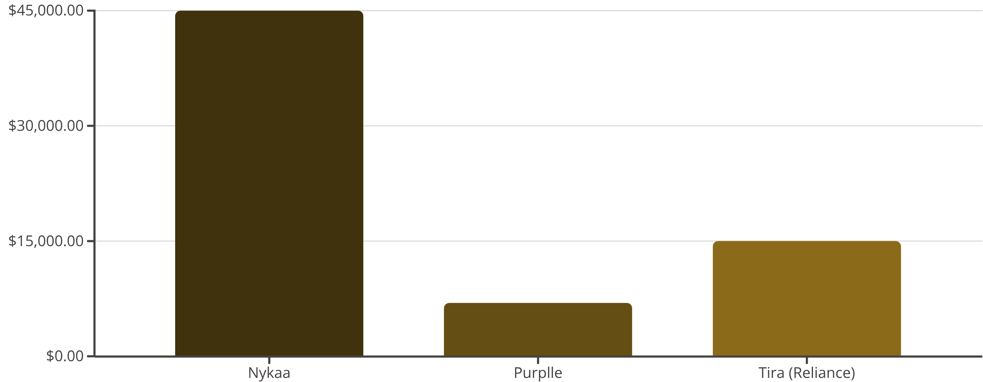
Nykaa's Stock Market Journey: A Competitive View
Below is a graphical representation of Nykaa's market capitalization compared to key competitors in the beauty and fashion e-commerce space. This highlights Nykaa's strong position within the industry.
Nykaa maintains a leading market capitalization, showcasing strong investor confidence built on its unique omnichannel model and established presence. While new entrants like Tira (backed by Reliance) are rapidly growing and Purplle offers aggressive pricing, Nykaa's strategic positioning and brand trust continue to give it a significant edge in the dynamic Indian beauty and wellness market.

Slide 13




Nykaa SWOT Analysis
Strengths
Weaknesses
Opportunities
Threats
Strong authenticity
High competition
Expansion into men’s grooming and Fashion
Market saturation
Omnichannel presence
Premium pricing
Rising competition
Wide selection
Dependency on logistics
International markets
Tech disruptions

Slide 14
Why Nykaa is Unique & Sustains in Market
Omnichannel Model
Strong Brand Trust
Content-to-Commerce Strategy
Combines online platform with 160+ offline stores across India.
Known for authenticity, especially in beauty & personal care.
Engages users through tutorials, influencer content, and beauty.
First-Mover Advantage
Private Labels
Customer Loyalty
Among the first Indian startups focused solely on beauty e-commerce.
High-margin in-house brands like Nykaa Cosmetics boost profitability.
Nykaa has a strong, repeat customer base—especially urban women.

Slide 15
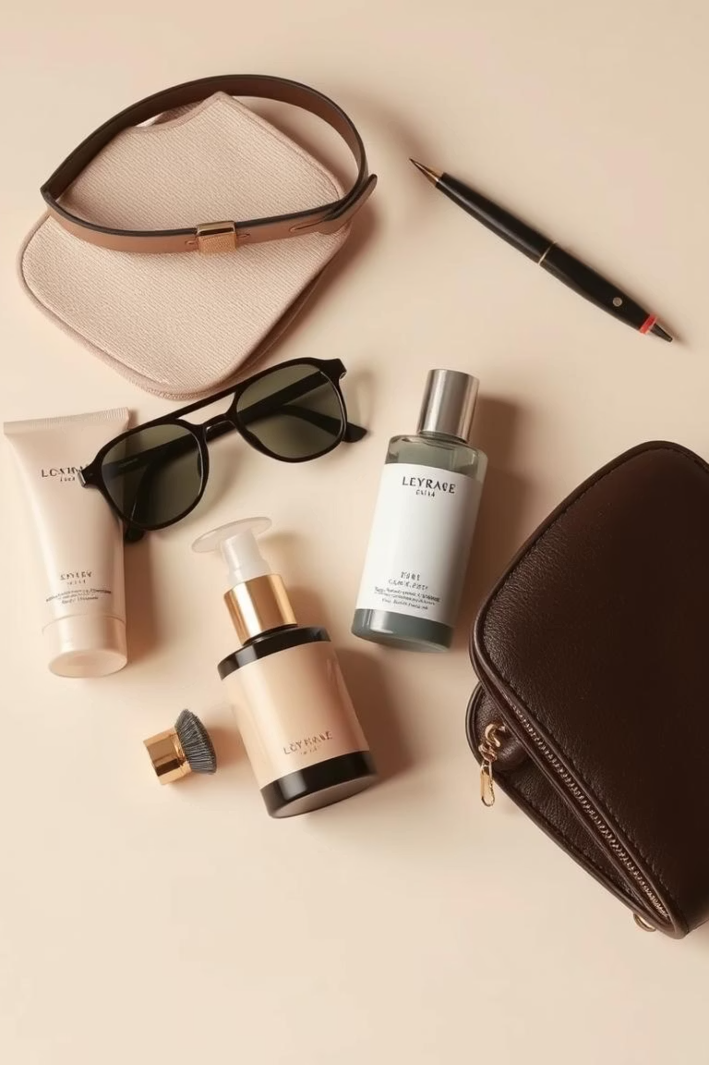
Nykaa’s Current Strategic Focus Areas
Nykaa Fashion – Expanding Lifestyle Portfolio
Focused on apparel, accessories, and footwear
Features premium & emerging Indian brands
Dedicated app for Gen Z & millennial audience
Expanding own labels like 20 Dresses and Likha
Nykaa Man – Tapping Male Grooming Segment
India’s first dedicated grooming platform for men
Offers skincare, haircare, beard care, and wellness
Targets fast-growing male grooming market in urban India
Partners with popular brands like The Man Company and Beardo

Slide 16

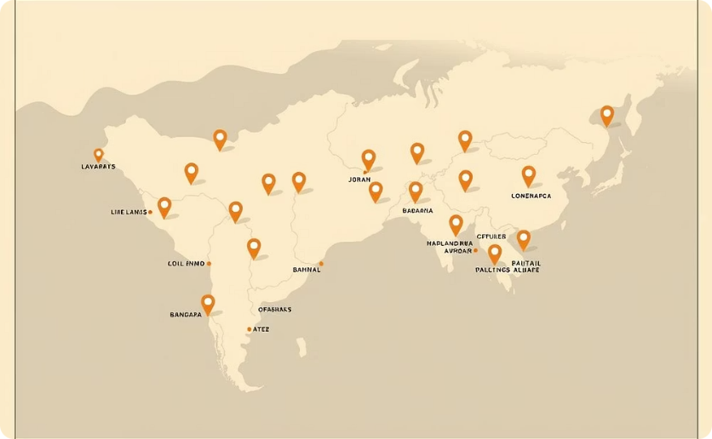


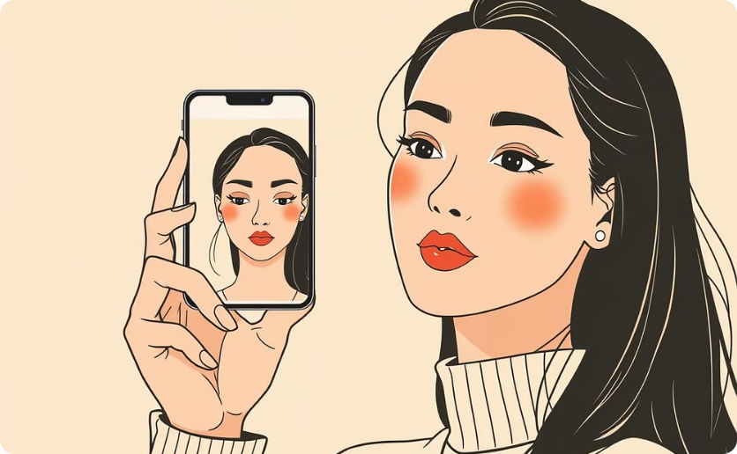

My Suggestions for Nykaa
Improve Customer Service: Enhance response time and resolution efficiency.
Expand Physical Stores: Increase footprint in Tier II cities for wider reach.
Focus More on Men’s Grooming: Aggressively target the growing men's personal care market.
Partner with Regional Influencers: Leverage local voices for authentic marketing.
Invest in AR/VR Features: Integrate virtual try-on experiences for enhanced app engagement.
Analyze Competitor Discounts: Adjust pricing strategies and offer competitive discounts based on competitor analysis.

Slide 17

Where is Nykaa Headed?
1
Improve AI-powered personalization on app
2
Expanding to international markets (Middle East, Southeast Asia)
3
Launching new in-house sustainable product lines
4
Increasing focus on fashion vertical (Nykaa Fashion)

Slide 18

Nykaa continues to be a leader in the beauty tech space with innovation, strong brand trust, and consumer engagement.

